Slide 1
DCAITI-Project: Implementation of a Traffic Light Service on an (Android) Smartphone
Oday Kabha oday.kabha@ipk.fraunhofer.de
Yiyang Song yiyang.song@campus.tu-berlin.de
Yuanheng Mu johanmu1994@mailbox.tu-berlin.de
Supervisor: Birgit Kwella
Notes:
<number>

Slide 2

Overview
Review of First Presentation
Current Implementations
Milestone
1
06.01.2021
DCAITI -Projekt

Slide 3
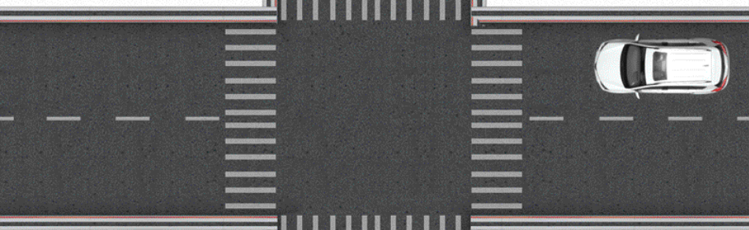
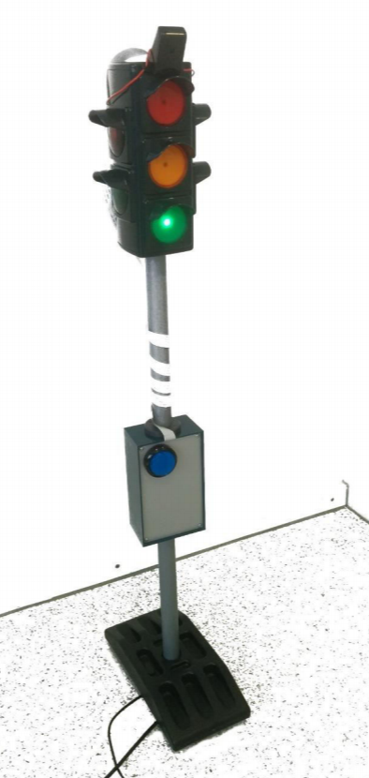
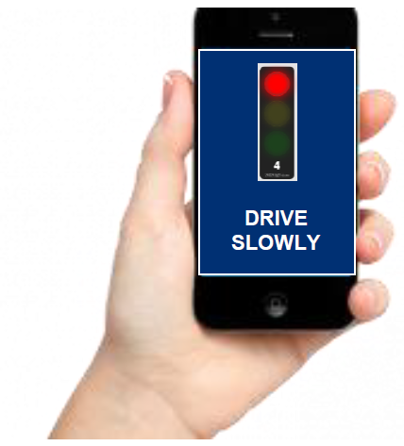
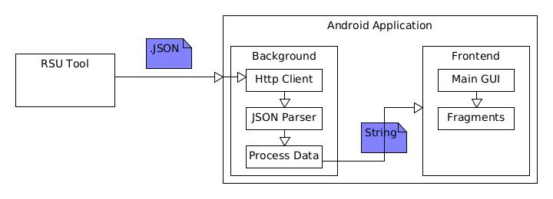
1.1 Review of First Presentation: Background & System Architecture
Background
System Architecture
RSU
SPaT & MAP
via automotive WiFi
1
06.01.2021
DCAITI -Projekt

Slide 4
Request, analysis and visualization of traffic lights information
Decision of driving strategy:
Determination of signal group
Generation of strategies
1.2 Review of First Presentation: Tasks
Simulation and evaluation
1
06.01.2021
DCAITI -Projekt

Slide 5
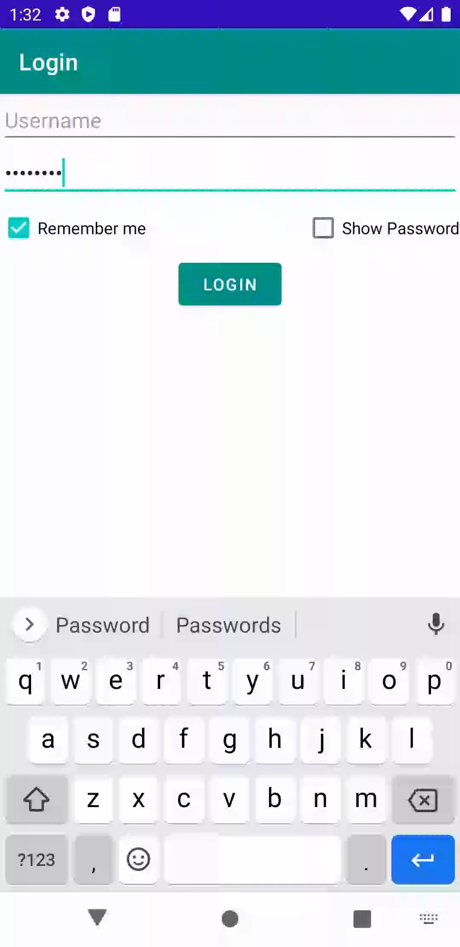
2.1 Current Implementations: Works about Client
Server:
FOKUS Traffic Light Service (simulated RSU)
Data to request:
SPaT & Map in JSON format
Authorization:
with TUB-Account
Functions:
Verify authorization,
Save username and password,
Hidden/Show password
1
06.01.2021
DCAITI -Projekt

Slide 6





2.2 Current Implementations: Works about Traffic Light Monitor
JSON Parser for SPaT
Parameters of interest:
IntersectionState.movementStates -> traffic lights
MovementState.movementEvents -> phases
MovementEvent.phaseState
TimeChange.likelyTime
Phase states:
DARK,
PROTECTED_MOVEMENT_ALLOED,
PROTECTED_CLEARANCE,
STOP_AND_REMAIN,
PRE_MOVEMENT
Likely time:
Timepoint, the end of this phase state in the current or next hour, with the unit of 0.1 sec
1
06.01.2021
DCAITI -Projekt

Slide 7
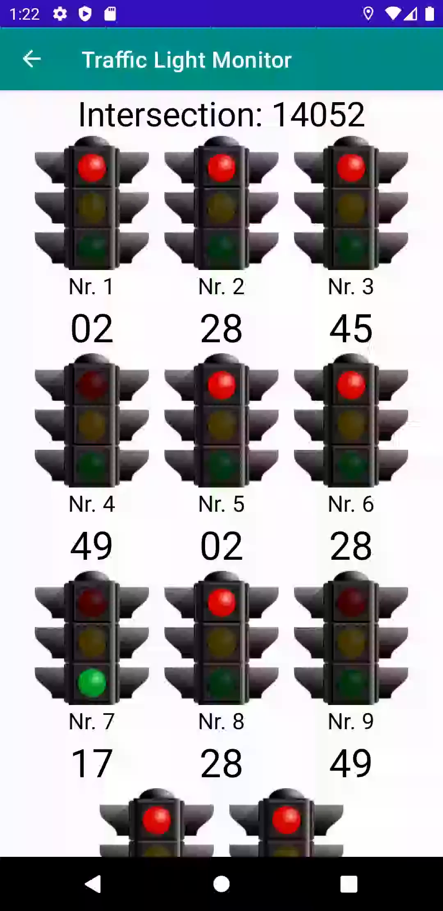
2.2 Current Implementations: Works about Traffic Light Monitor
Traffic light phase example 1:
Dark
Move
Clear
Traffic light phase example 2 and current state to determinate:
Current Time
Likely Time of State Stop
Time Left
Stop
Pre
Move
Clear
1
06.01.2021
DCAITI -Projekt

Slide 8
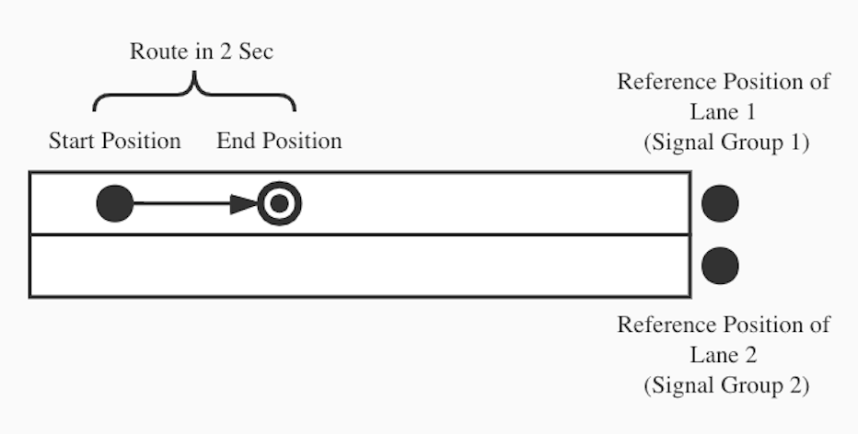
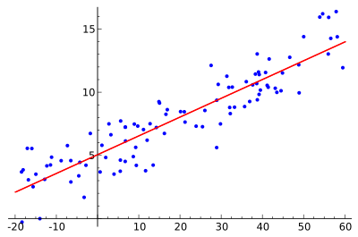
2.3 Current Implementations: Works about Determination
Algorithm 1
Linear Regression
Not suitable for real lane, which often in curve not straight line
1
06.01.2021
Source: https://de.wikipedia.org/wiki/Lineare_Einfachregression
DCAITI -Projekt

Slide 9
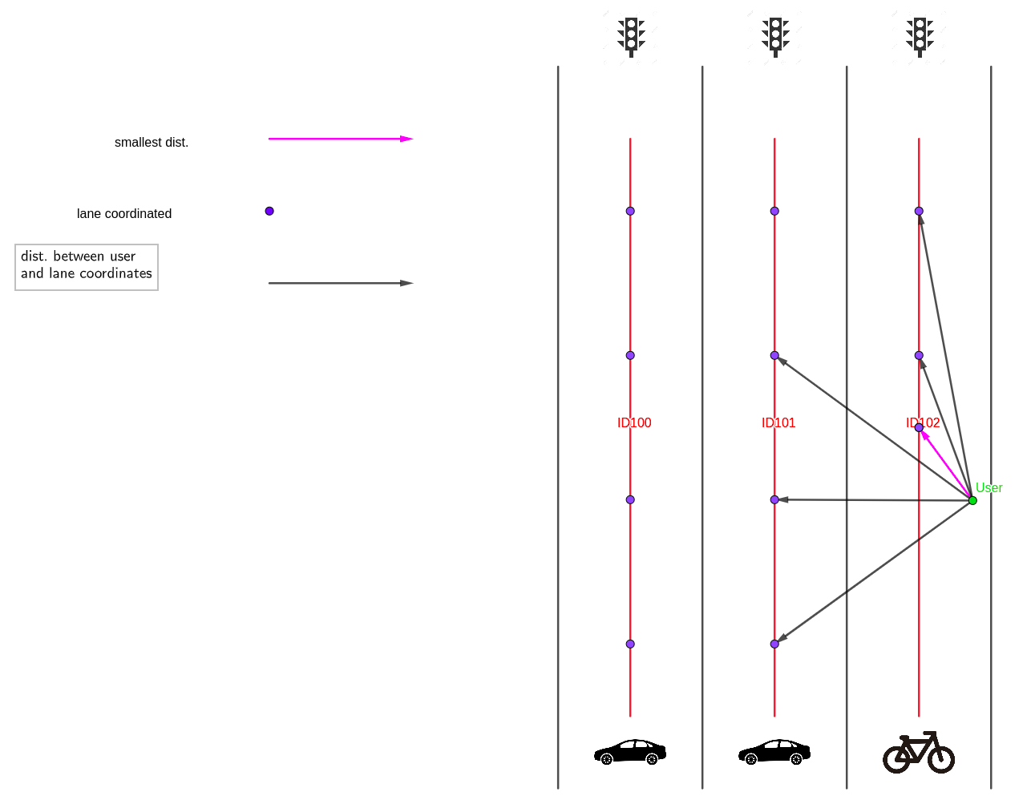
2.3 Current Implementations: Works about Determination
Algorithm 2
Min Distance to Lane
Needs to add points in the curve of Lane to decrease deviation
After estimating min dist. => return laneID which contains the desired point.
1
06.01.2021
DCAITI -Projekt

Slide 10
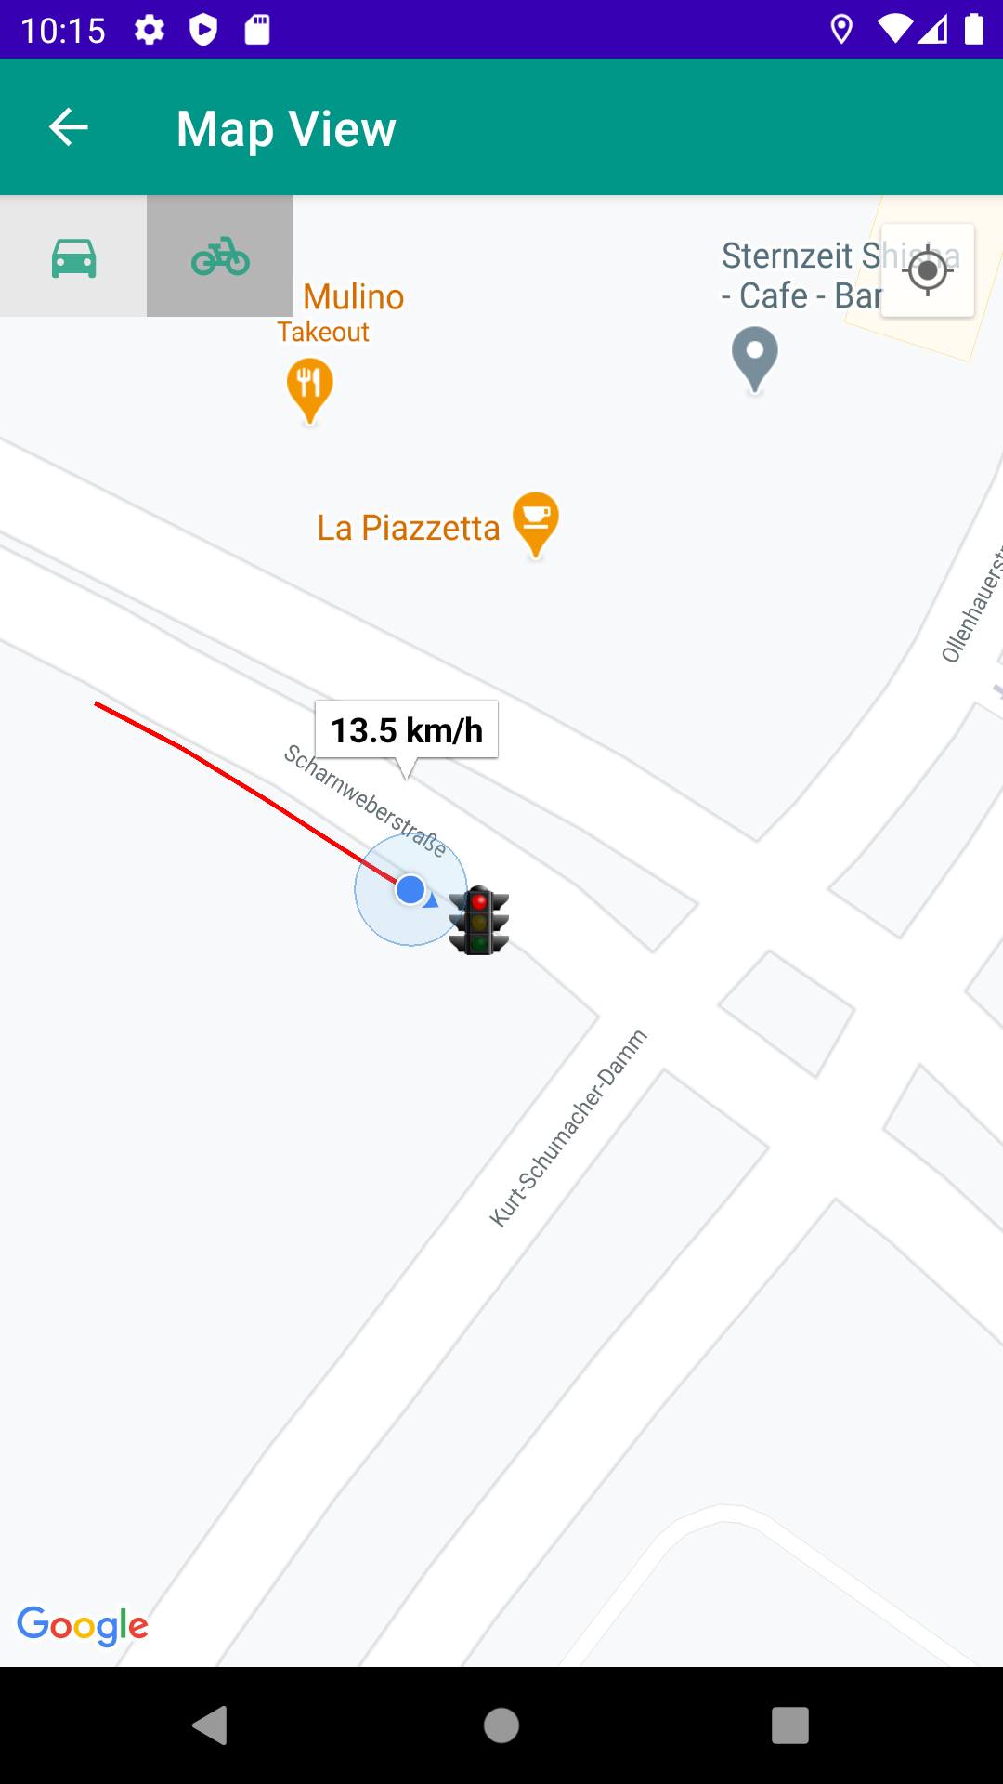



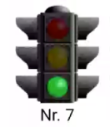
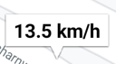
2.4 Current Implementations: Works about Map View
Google Maps Platform API
SupportMapFragment
Google Map API Key
The My Location layer:
Polyline:
Marker:
1
06.01.2021
DCAITI -Projekt

Slide 11
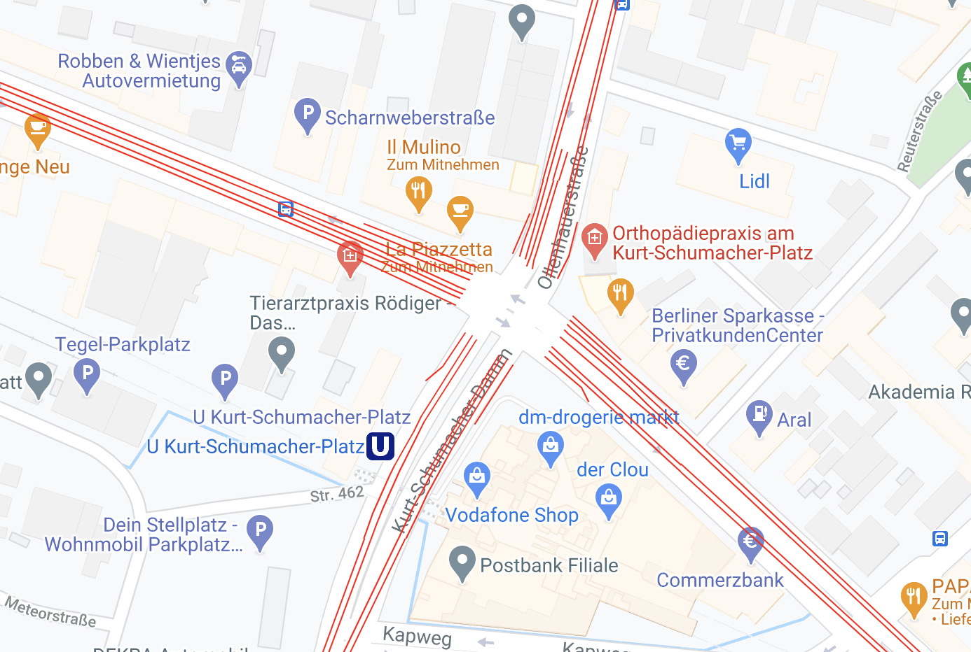
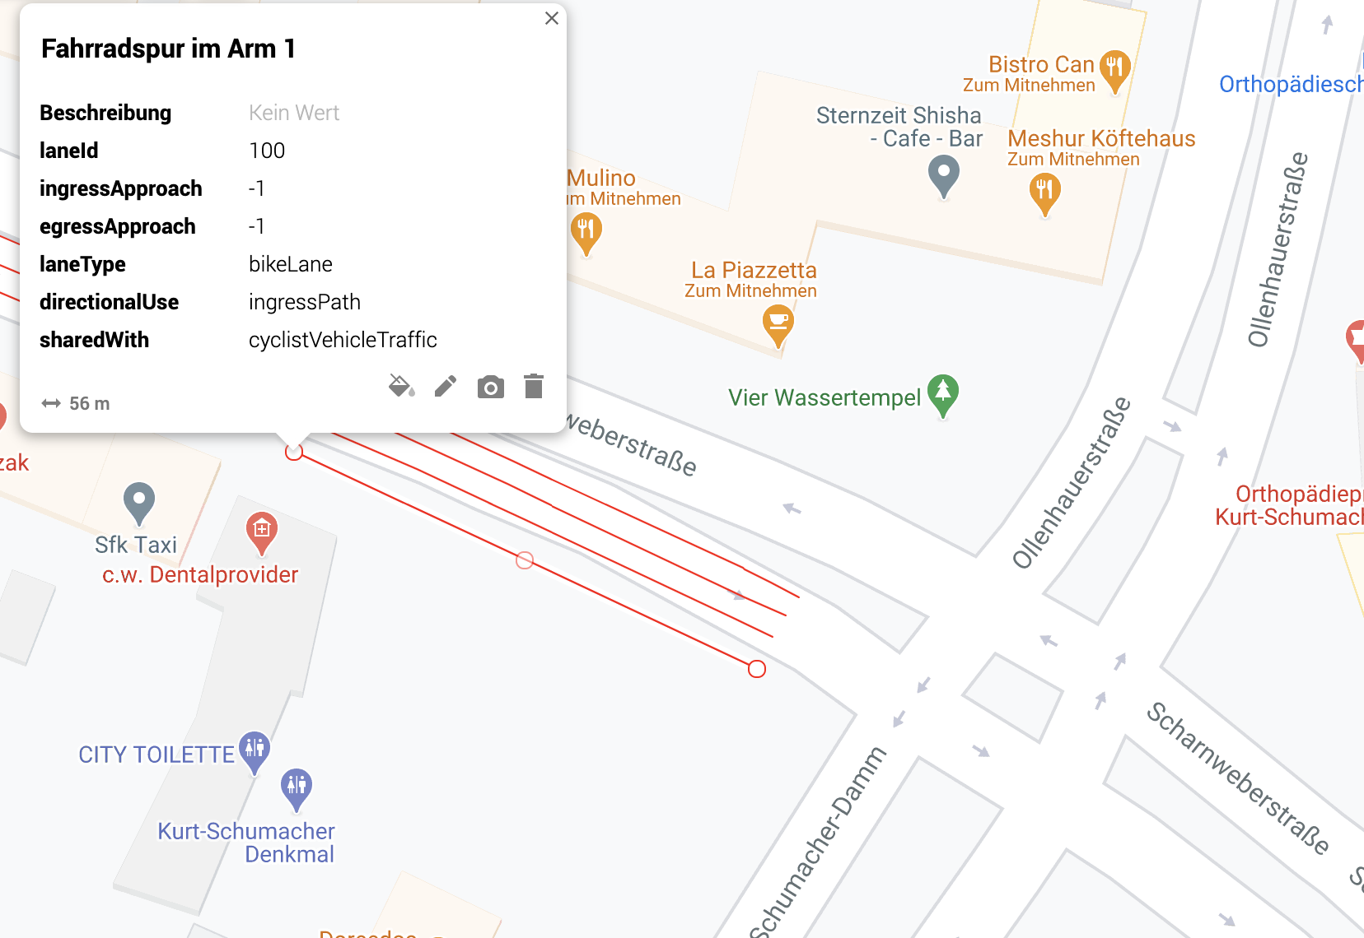
2.5 Current Implementations: Works about Simulation
Decide which lane to use for the simulation
Routes Information in KML File
The Lane of Bicycle with ID 100 selected to test
1
06.01.2021
DCAITI -Projekt

Slide 12
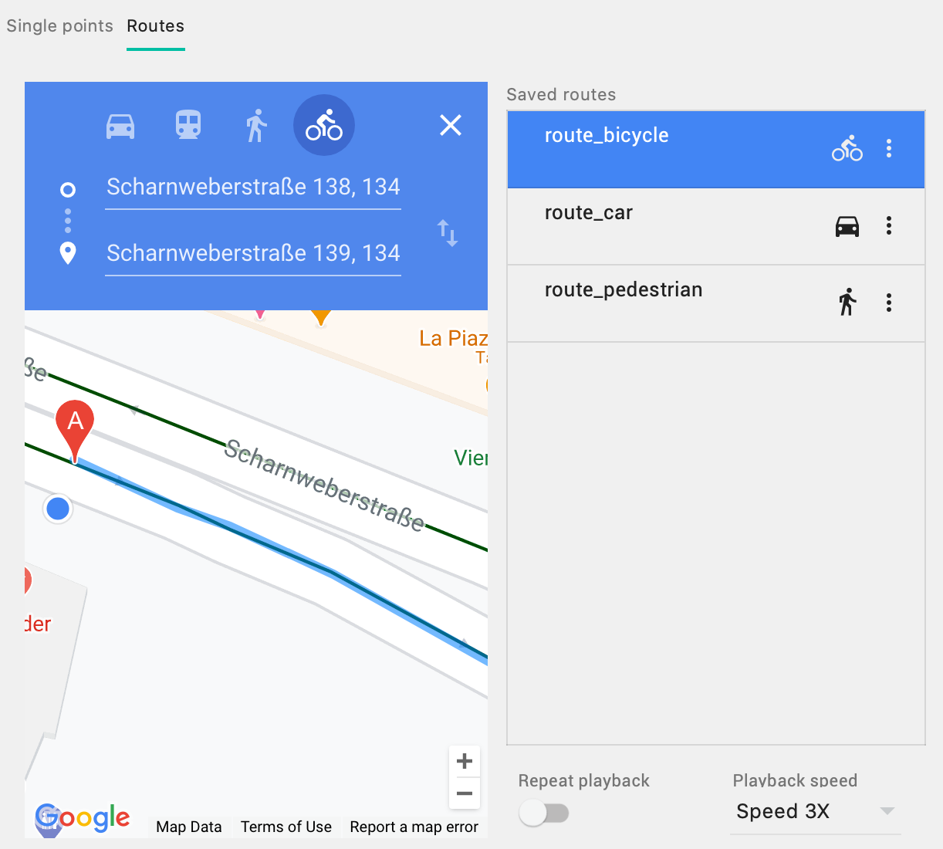
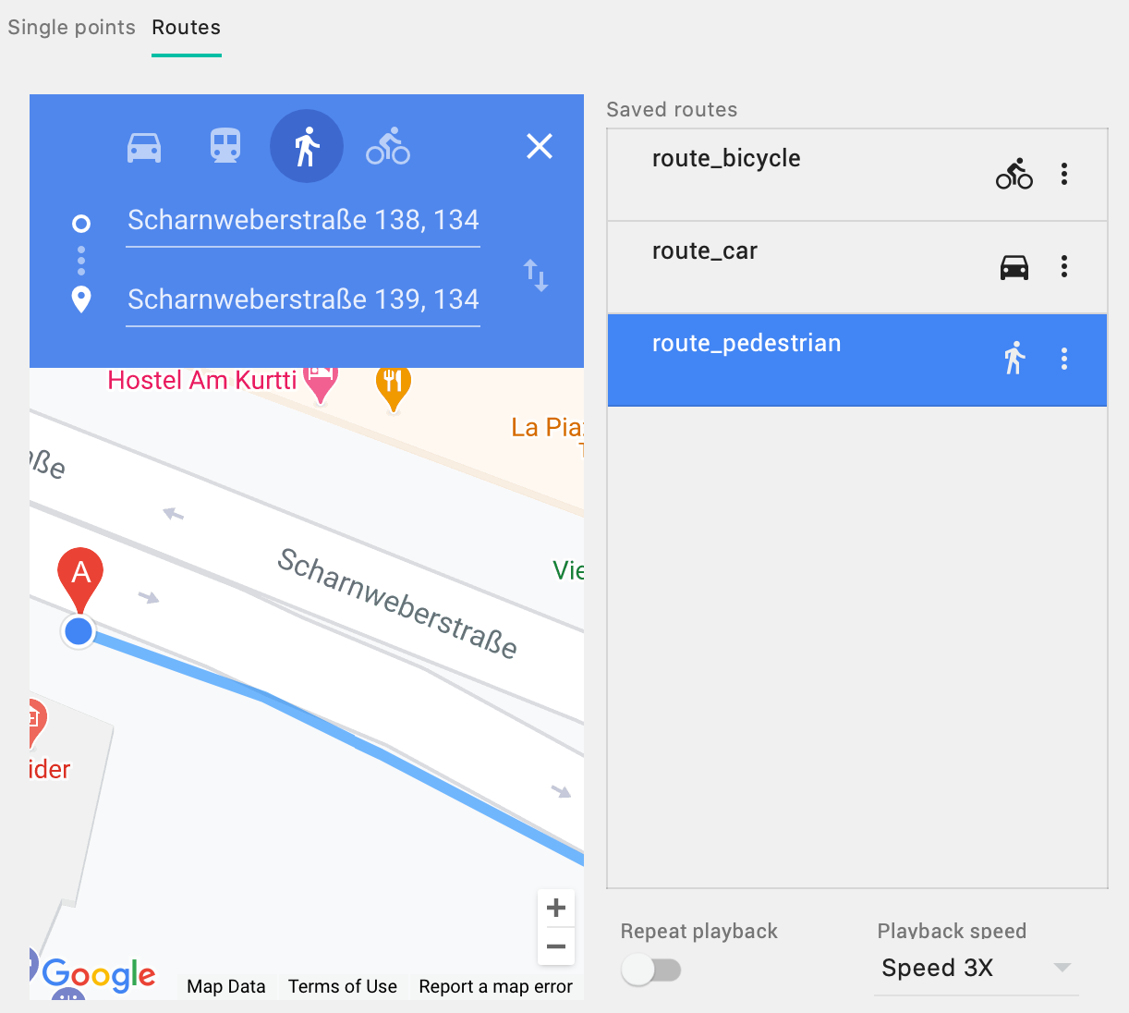
2.5 Current Implementations: Works about Simulation
Simulate route in Android Emulator
1
06.01.2021
DCAITI -Projekt

Slide 13
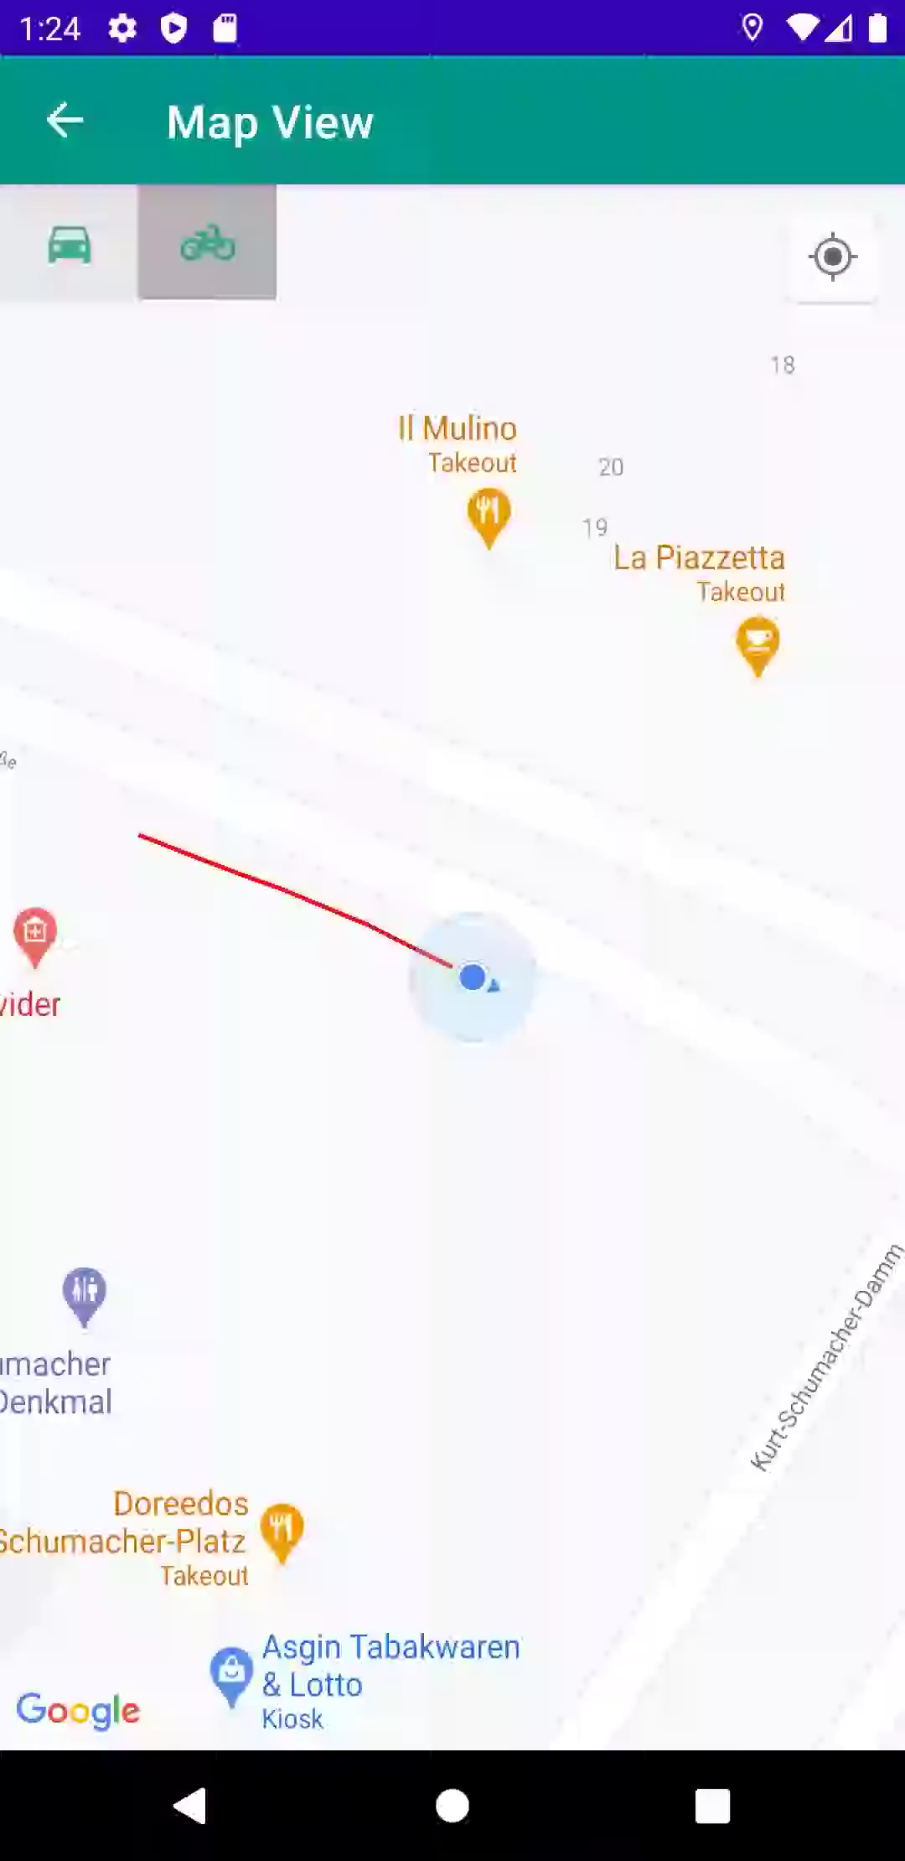
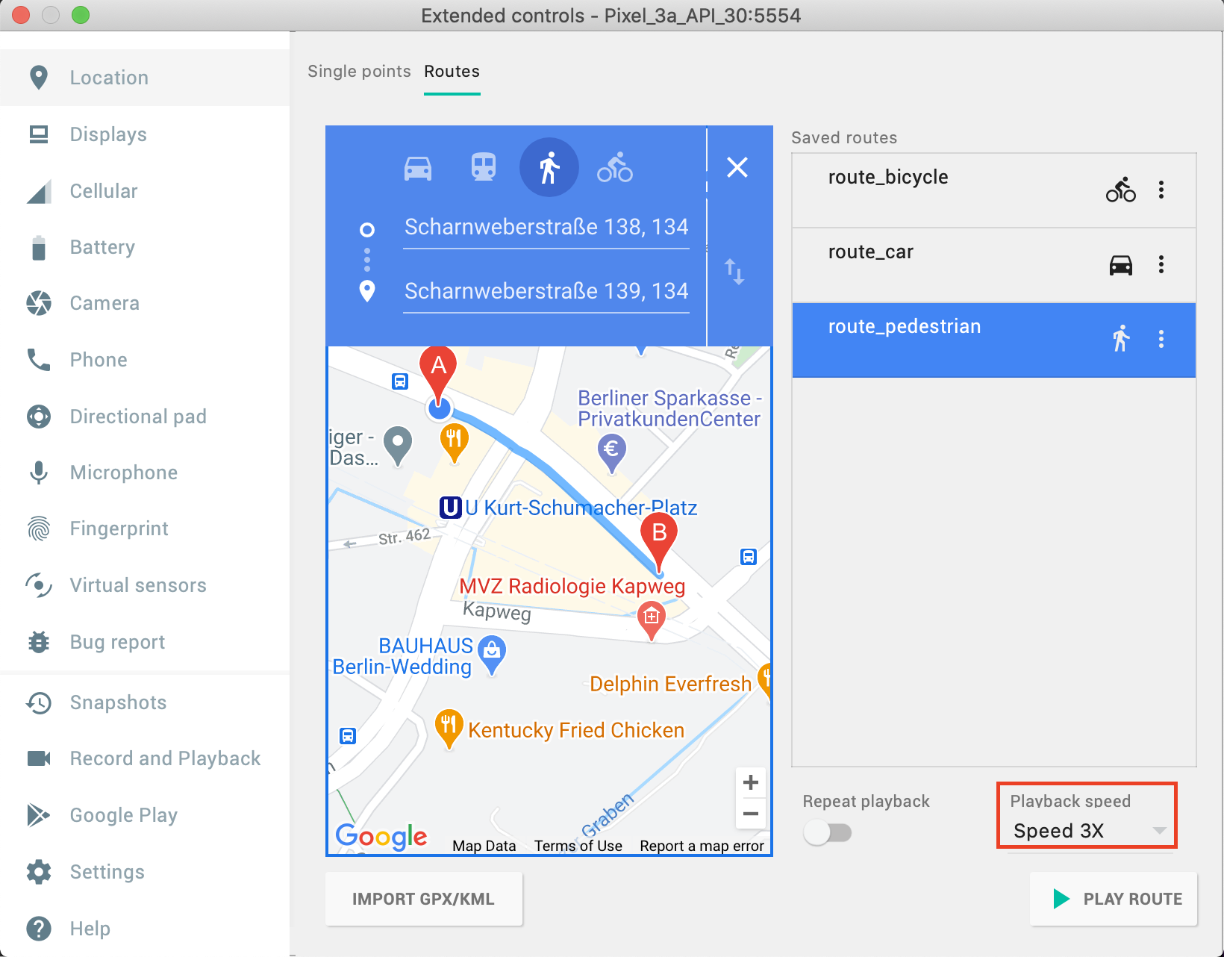

2.5 Current Implementations: Works about Simulation
Simulating Result
Route of pedestrian with Speed 3X: around 13.5km/h
1
06.01.2021
DCAITI -Projekt

Slide 14
3. Milestone
1
06.01.2021
DCAITI -Projekt

Slide 15
Thanks for your attention!
Oday Kabha oday.kabha@ipk.fraunhofer.de
Yiyang Song yiyang.song@campus.tu-berlin.de
Yuanheng Mu johanmu1994@mailbox.tu-berlin.de
Notes:
<number>

